Slide 1
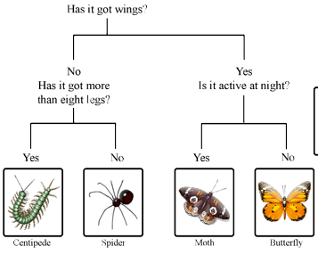
Dichotomous Keys – Page 1
Imagine you're in a forest, and you find a really cool leaf or bug you've never seen before. How would you figure out what kind it is? Scientists use something called a dichotomous key to identify unknown organisms, like plants, animals, and insects. It's a tool that helps them tell one type of thing from another, kind of like a roadmap to identification!
What is a dichotomous key used for? ___________________________________________________________________
Can you name an organism that a scientist might use a dichotomous key to identify? ___________________________________________________________________
If you were in a forest and found a plant you didn’t recognise, how could a dichotomous key help you? ___________________________________________________________________
Now, you might wonder, how does a dichotomous key work? A dichotomous key is organized in steps with two options at each step, that's why it's called "dichotomous", because 'di' means 'two'. It gives you two descriptions at each step and you need to decide which one fits your organism best. It's like a game of "Would You Rather?“ or “This or That”.
What does “di” mean and how does it relate to how the key works? ___________________________________________________________________
Can you explain how a dichotomous key works in your own words? ___________________________________________________________________
Why do you think it’s important for a dichotomous key to only give two options at each step? ___________________________________________________________________

Slide 2
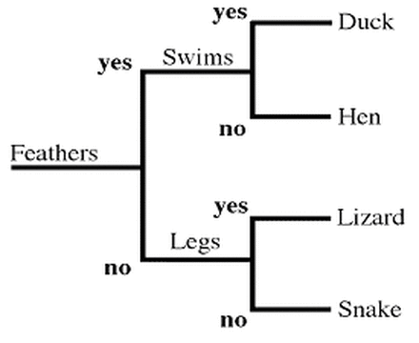
Dichotomous Keys – Page 2
Let's think of an example. Say you have an insect. The dichotomous key might ask first, "Does the insect have wings or not?" If your insect has wings, you go to the next question that describes insects with wings. If it doesn't, you go to the question that describes insects without wings. You keep making these choices until you find out what your insect is!
Can you give an example of a choice you might make using a dichotomous key? __________________________________________________________________
How would the dichotomous key’s questions change if the insect didn’t have wings? __________________________________________________________________
What would the next step be if your insect does have wings, according to the dichotomous key? __________________________________________________________________
Using the key on the right, we can figure out what animal is what based on its observable characteristics. In this group of animals, if it has feathers and swims, it’s a duck. But, if it has feathers and doesn’t swim, it is a hen.
Which animal has feathers and swims? __________________________________
Which animal has legs, but no feathers? __________________________________
Group these animals based on if they have feathers or don’t have feathers:
Parrot
Monkey
Tiger
Owl
Has feathers | Doesn’t have feathers

